Slide 1


Applying for MA Early College Designation: Part A
For Applicants Interested in Applying for MA Early College Designation
May 2021

Slide 2
Early College Works
A random assignment study performed in 2014 on a sample of 4000 students across 19 early college high schools in North Carolina shows early college students are almost 2x as likely to earn a degree for all sub-groups
Similar results have been achieved in other states as well
Source: January 2014. “The Impact, Costs, and Benefits of NC’s Early College Model,” Presentation by Edmunds, J., Unlu, F., Tsai, T., and Glennie, E.; SERVE Center, UNC Greensboro, NC.

Slide 3
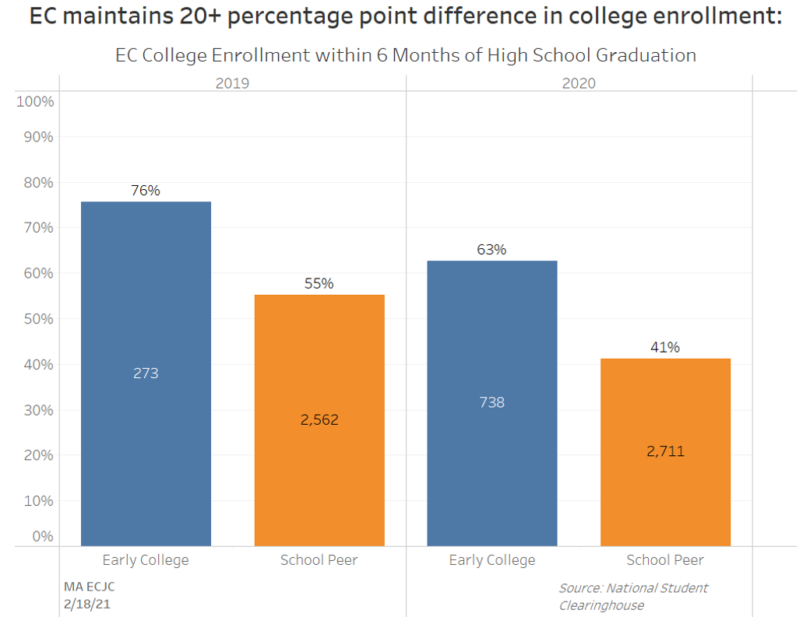
Initial Outcome Data from MA EC Programs

Slide 4
Defining “Early College” in MA
MA Early College provides a structured program of study and supports that increases college success and career readiness, prioritizing students historically underserved in higher education.
Cohorts of students:
Take at least 12 credits of strategically sequenced college courses during their regular (or intentionally redesigned and integrated) high school day, at no cost to themselves or their families
Receive enhanced academic and non-academic guidance and support prior to beginning, and during, college coursework to ensure that they both successfully complete rigorous courses and thrive in the college environment
Learn how their guided academic pathways are related and connected to career opportunities
Benefit from being part of an Early College community that eases the transition from high school to college
Graduate from high school with a significant number of college credits, habits, and skills needed to be successful in college and career, increasing the likelihood they will continue with college after high school and reducing the cost and time to degree completion.

Slide 5
Designation Promotes…
More equitable access to higher education for underserved students
Alignment between K-12 schools and local public institutions of higher education (IHEs)
Enhanced career advising (MyCAP)
Immersive college exposure for secondary students
High school realignment and redesign
Potential industry partnership/support for schools
State-convened community of practice

Slide 6
Once Designated, Programs…
Will have access to technical assistance, and the EC community of practice, including bi-weekly check ins and topically relevant seminar series
Will have access to Data Dashboards of their programs, to assist in determining whether your program is meeting state and partnership objectives
Will begin a 5 year annual reporting cycle, with annual reporting, site visits, and a cumulative program review at the end of the cycle
Will receive the opportunity to apply for state funding, as it arises

Slide 7
Timeline of Designation Process
May 3rd: Application and Companion Document available online
June 30th: Letter of Intent due
Summer 2021: Office hours and TA
August 27th: Part A applications due
_____________________________________________________
October 2021: Announcement of applicants moving onto Part B, application sent to applicants directly
December 2021: Part B Applications due
Winter 2021-2022: Interviews held
March 16, 2021: Recommendations for Designation made to ECJC
Notes:
For more information, and access to the relevant links, visit our webpages here:
- https://www.doe.mass.edu/ccte/early-college/
- https://www.mass.edu/strategic/earlycollege.asp
Companion Document Link
https://www.doe.mass.edu/ccte/early-college/companion-2021.pdf

Slide 8
Submitting the Application
Both Part A and Part B applications are within Alchemer (survey instrument). Questions are sorted by guiding principle
Alchemer
Letter of Intent, Part A, and Part B to be submitted electronically
Capabilities to save and return and download responses
No question is "required" so that applicants can move forward and backward, but expectation is that all questions are completed
If file attachments are too large to download, please email them to Rebekah.Barr@mass.gov
Notes:
Intent to Apply link here: https://survey.alchemer.com/s3/6318775/Early-College-Designation-Intent-to-Apply-2021

Slide 9
Application Overview – Part A
Part A:
“Designation Criteria related to planning”
Uploading of plans and sharing of intentions and program design
Technical assistance
Guiding Principles PLC – begins May 18th
Part A Timeline:
Application available online
Summer 2021: Office hours and TA
August 27th: Part A applications due
Notes:
Link to register for Guiding Principles PLC, held bi-weekly at 9am starting May 18th
https://zoom.us/meeting/register/tJcoduCppjkvHdVrHf2uVox3vWfJ2xfkiFPc

Slide 10
Narrative Descriptions and Overview
Part A requires descriptions and narratives of planning and intentions
“Describe the program’s initial plan for outreach and prioritized recruitment of students who are traditionally underrepresented in higher education”
“Upload the program’s preliminary course scope and sequence and indicate how the college coursework meets MassCore…”
Part A applications should indicate a programs’ dedication to developing a program that meets the five Guiding Principles

Slide 11
Application Overview: Part B
Part B:
“Final Designation Criteria”
Uploading evidence of materials
Technical assistance
Partnership Interviews held with department staff
Part B Timeline:
October 2021: Announcement of applicants moving onto Part B, application sent to applicants directly
December 2021: Part B Applications due
Winter 2021-2022: Interviews held
March 16, 2021: Recommendations for Designation made to ECJC

Slide 12
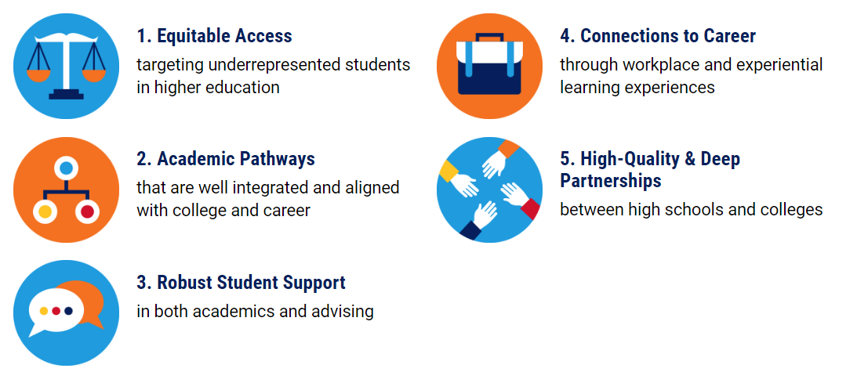
Overview of Guiding Principles

Slide 13
Some Highlights from Guiding Principle 1: Equitable Access
EC program should be open to all students. Students should not be excluded from participation based on prior or current GPAs, test scores, or placement scores. Whenever possible, students should not be excluded based on prior disciplinary records
Enrollments should not rely solely on teacher recommendations or other highly subjective processes
Programs should conduct prioritized outreach, recruitment, and enrollment of populations underrepresented in higher education (vs. open enrollment to all with no intention)
Notes:
-school data analyzed to demonstrate need
-initial plan for scale
-outreach and recruitment plan
-enrollment policy

Slide 14
Some Highlights from Guiding Principle 2 – Guided Academic Pathways
The scope and sequence of the college coursework must allow students to meet MassCore and MassTransfer requirements and earn a minimum of 12 college credits
Programs should design “on-ramps” and preparatory academic work for students to access multiple measures of college readiness for coursework
All students must participate in MyCAP
Program coursework and related activities and supports take place during the school day

Slide 15
Some Highlights from Guiding Principle 3 – Enhanced Student Support
Programs should identify potential challenges and corresponding supports for targeted EC students
Programs should plan both academic and non-academic supports: i.e. tutoring, counseling/advising, peer mentors,
Programs should plan to integrate staff support from both institutions

Slide 16
Guiding Principle 4 – Connections to Careers
Programs should design a college and career counseling plan (utilizing MYCAP) that includes early career development, career and postsecondary education exploration, employability skills, and labor information in ways that assist Early College students in connecting college coursework and plans to a fulfilling career choice.
Programs should think strategically about what connections with possible area employer partners will benefit their Early College program

Slide 17
Guiding Principle 5 – Effective Partnerships
Applicant partners should be fully integrated in the program work
Partners should identify key costs related to starting and sustaining the program
Partners should identify program leadership at each partner institution, as well as any other major stakeholders
For each proposed pathway, partners should consider graduation requirements, course taking requirements, pathways to any relevant credentials, and transferability

Slide 18
Technical Assistance – NS4Ed
Office hours
Access to resource site
Webinars
Community of practice/online forums
Joseph Goins
jgoins@ns4ed.com
www.MAEarlyCollege.com
Password: MAECP

Slide 19
Early College Team
Dr. Kristin Hunt
http://www.doe.mass.edu/ccte/ccr/hqccp/
https://www.mass.edu/strategic/earlycollege.asp
Statewide Director of Early College programs
Kristin.E.Hunt@mass.gov
Rebekah Barr
Early College Program Specialist
Rebekah.Barr@mass.gov
Yaw Asante-Bio
LEE Fellow
Pierre Lucien
SDP Fellow

Slide 20
Q&A

